Slide 1
Proposed Content
Title: Effective Data Visualization for Actuaries
Session Description:
As actuaries, we are expected to understand the structure and rationale behind complex statistical models. Beyond that, we need to evaluate. whether one model is preferred over another in a well-defined business context. Finally, these conclusions must be shared with stakeholders who are then expected to digest and support the actuary's conclusions. Although data visualization is often touted as having maximal benefit for the last step of the process, we contend that it provides value throughout
In this session, Brian Fannin and Jordan Bonner will highlight key actuarial concepts and exhibits that can be better understood through data visualization. R’s `ggplot2` package will be used to create exhibits that allow for a deeper level of understanding and intuition. By growing comfortable with the value and mechanics of visualization at all stages of the analytics cycle, actuaries will become more facile in communicating with any stakeholder at any stage.
Learning Objectives:
Unlock a deeper understanding of complicated concepts through data visualization
Leverage R’s `ggplot2` package to create compelling actuarial exhibits
Restructure data visualizations to tell the right story for your audience
To Be Removed. For Reference Only.

Slide 2
Ideas for Interactivity
Familiarity with R
“Which chart is easier to interpret”
Test Bar/Line bias (https://bit.ly/3ymQ1eE)

Slide 3
Effective Data Visualization for Actuaries
Brian Fannin
Jordan Bonner

Slide 4
Antitrust Notice
The Casualty Actuarial Society is committed to adhering strictly to the letter and spirit of the antitrust laws. Seminars conducted under the auspices of the CAS are designed solely to provide a forum for the expression of various points of view on topics described in the programs or agendas for such meetings.
Under no circumstances shall CAS seminars be used as a means for competing companies or firms to reach any understanding – expressed or implied – that restricts competition or in any way impairs the ability of members to exercise independent business judgment regarding matters affecting competition.
It is the responsibility of all seminar participants to be aware of antitrust regulations, to prevent any written or verbal discussions that appear to violate these laws, and to adhere in every respect to the CAS antitrust compliance policy.

Slide 5
Agenda
Seeing is Believing
Decoding Complexity
The Power of Persuasion

Slide 6
Seeing is believing

Slide 7
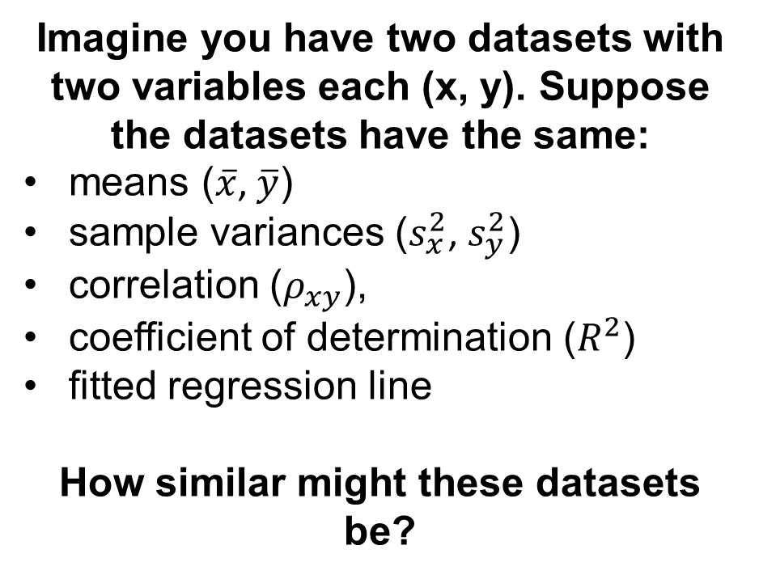
Seeing is Believing
Imagine you have two datasets with two variables each (x, y). Suppose the datasets have the same:
means ($\overline{x}$, $\overline{y}$)
sample variances ($s_{x}^{2}$, $s_{y}^{2}$)
correlation ($ρ_{xy}$),
coefficient of determination ($R^{2}$)
fitted regression line
How similar might these datasets be?

Slide 8
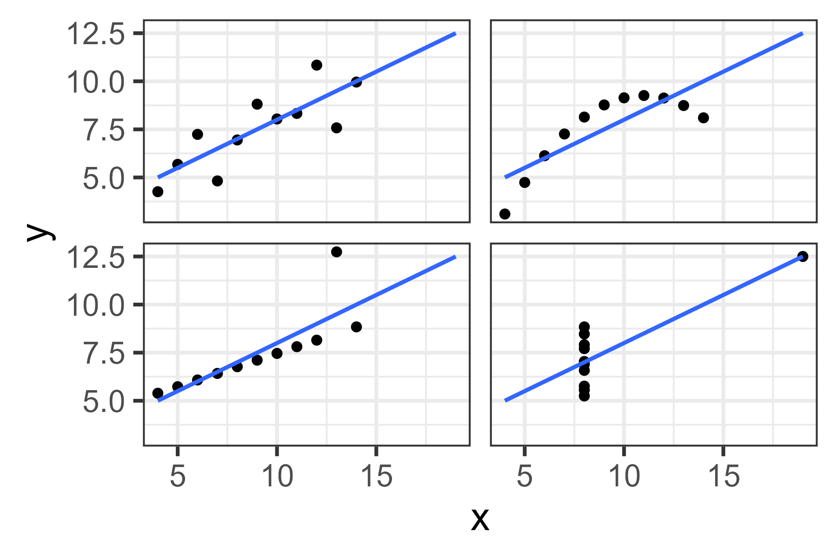
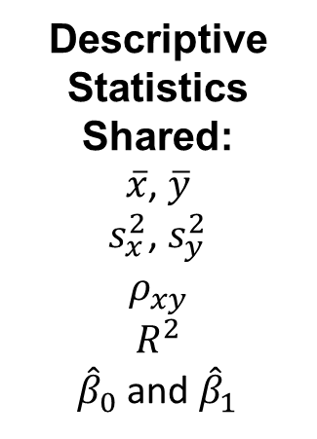
Anscombe’s Quartet
Descriptive Statistics Shared:
$\overline{x}$, $\overline{y}$
$s_{x}^{2}$, $s_{y}^{2}$
$$ρ_{xy}$$
$$R^{2}$$
${\hat{β}}_{0}$ and ${\hat{β}}_{1}$

Slide 9

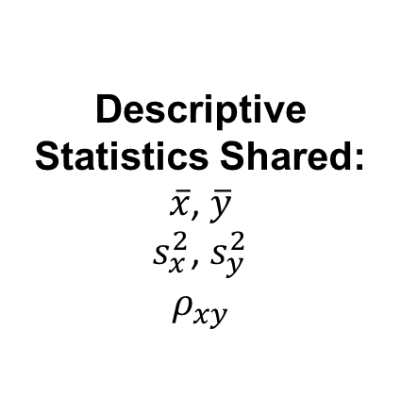
The Datasaurus Dozen
Descriptive Statistics Shared:
$\overline{x}$, $\overline{y}$
$s_{x}^{2}$, $s_{y}^{2}$
$$ρ_{xy}$$

Slide 10
Why Seeing is Believing:
Better Pattern Identification
Identifying Outliers
Spotting the “Big Picture”
Memory Retention

Slide 11
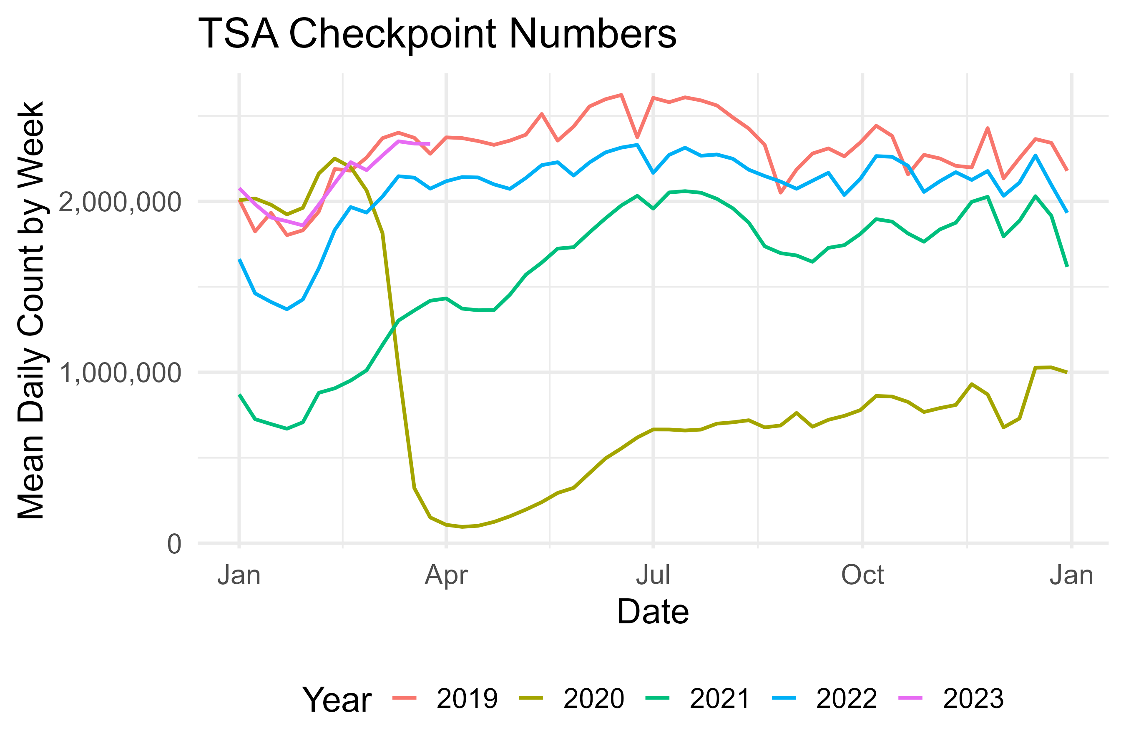
Better Pattern Identification
Seasonality
Notes:
We could also show an exhibit on Loss Development here, too? Not sure.

Slide 12
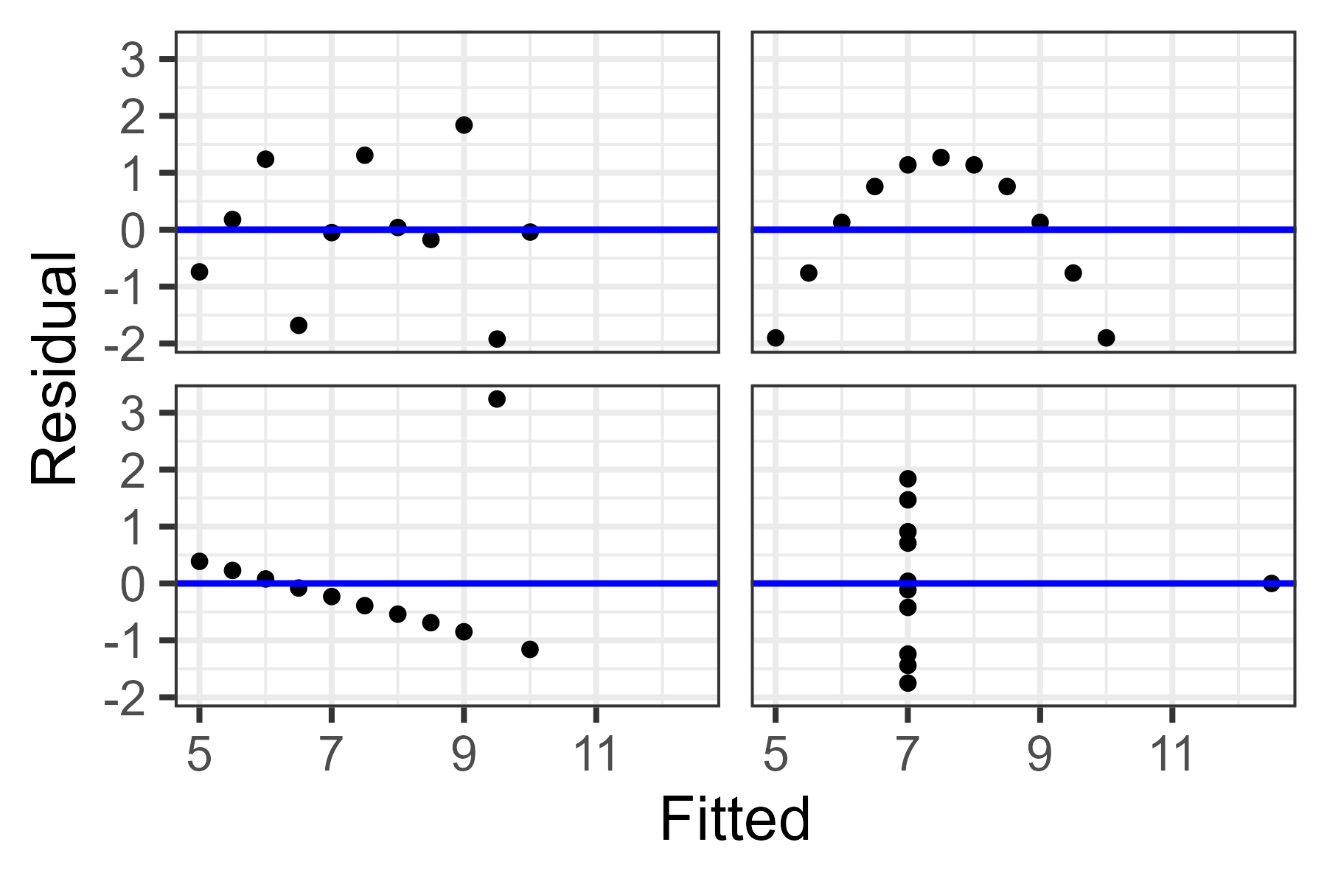
Identifying Outliers
Model Residual Plots
Notes:
We could also show an exhibit on box plots here, too? Not sure.

Slide 13
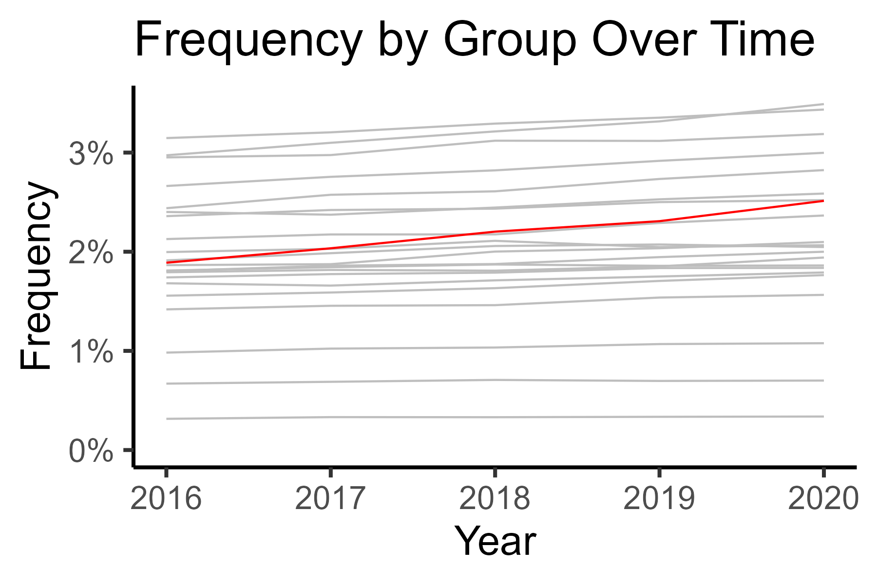
Spotting the “Big Picture”
Notes:
Could we show line chart over time with a particular group behaving clearly different?

Slide 14
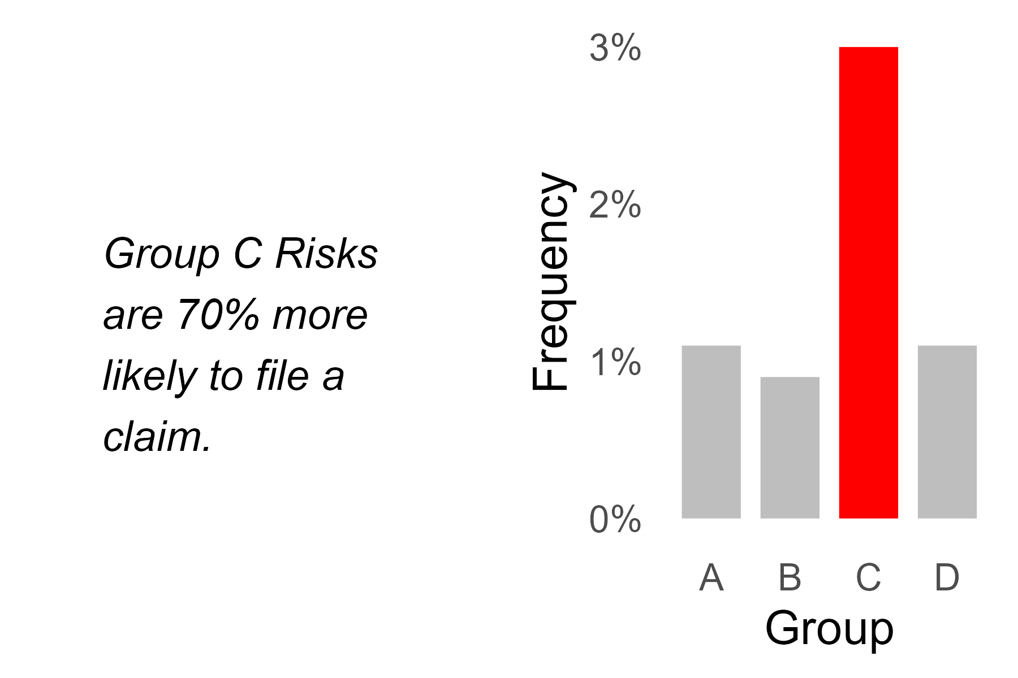
Memory Retention
Notes:
Which are you more likely to remember?

Slide 15
Decoding Complexity

Slide 16
Decoding Complexity
Univariate Linear Regression
Principal Components Analysis
Decision Trees
Correlation & Tail Correlation

Slide 17
The power of persuasion

Slide 18
The Power of Persuasion
Highlighting Key Insights
Telling a Story
Providing Context
Show Comparisons

Slide 19
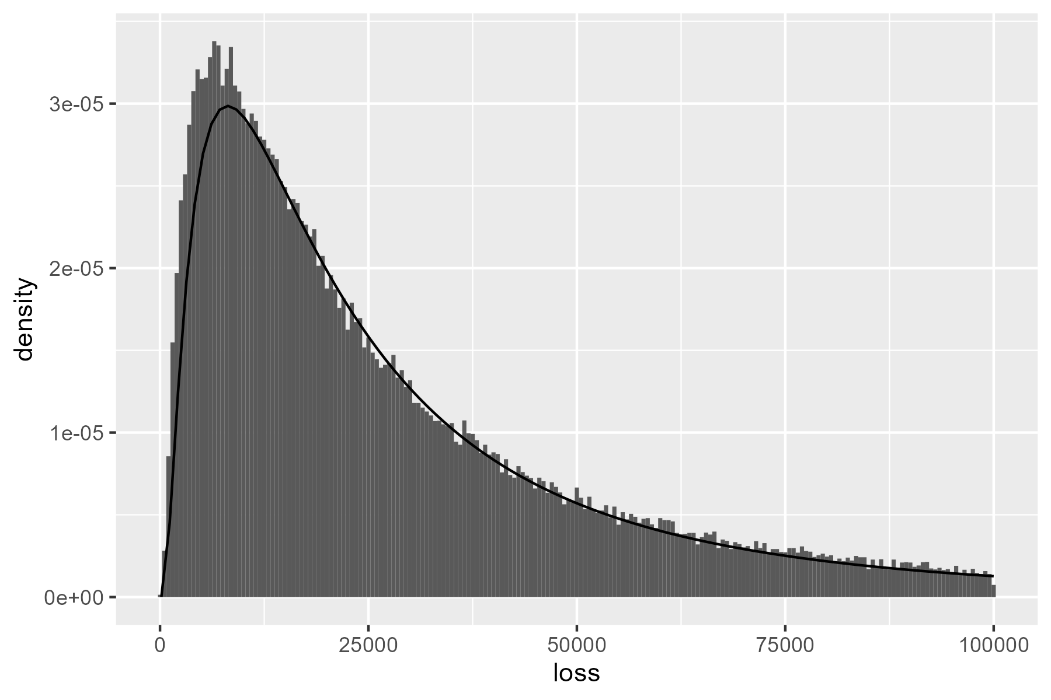
Initial Example: Fitted Severity
How can we improve upon this chart?
p <- data |>
geom_histogram(aes(x = loss, after_stat(density)) +
stat_function(fun = dlnorm,
args = list(meanlog = 10, sdlog = 1.0))

Slide 20
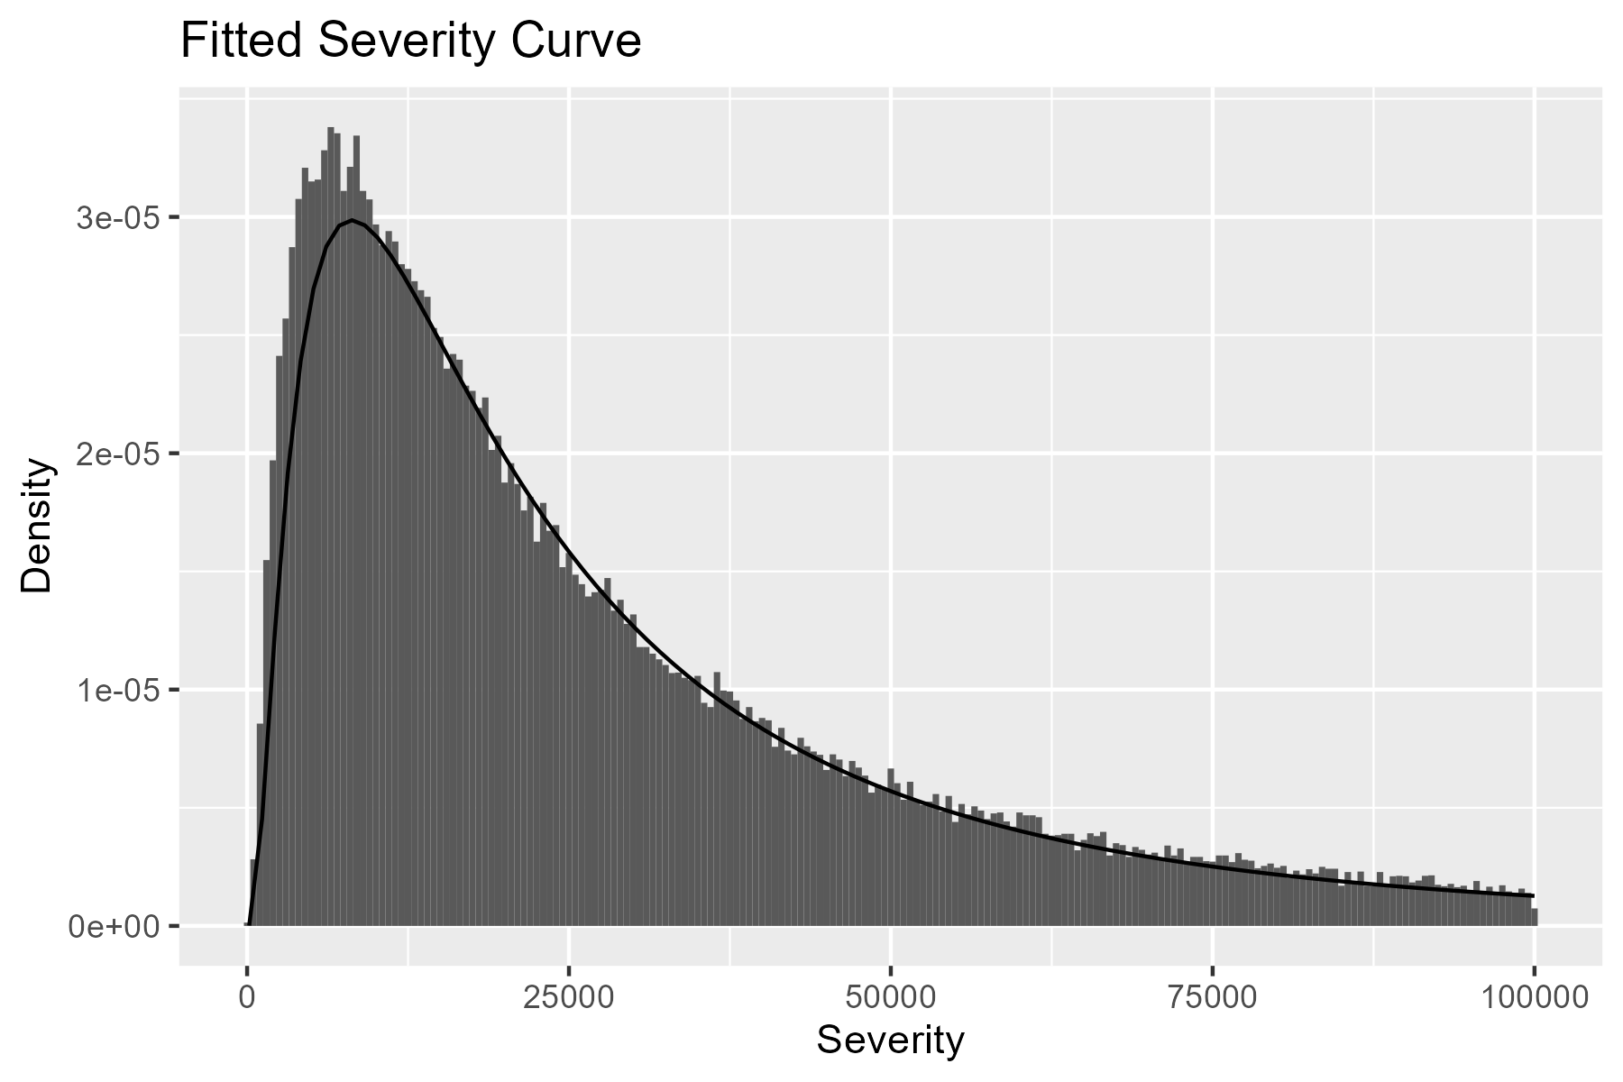
Titles & Renaming Variables
Adding a title and variable names goes a long way.
p <- p +
labs(
x = "Severity",
y = "Density",
title = "Fitted Severity Curve"
)

Slide 21
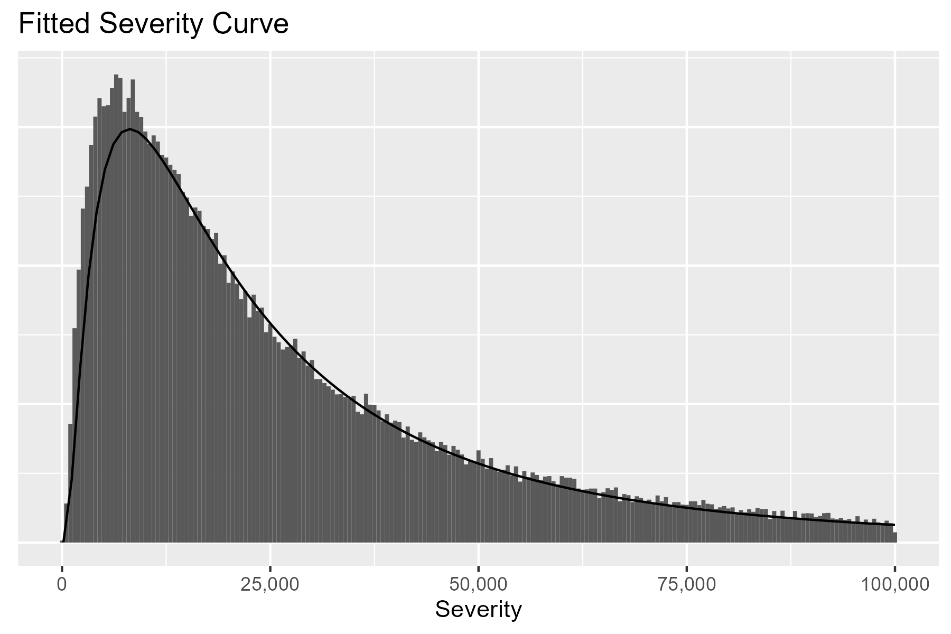
Cleaning Axes
We can change the x-axis labels and remove the y-axis.
p <- p +
scale_x_continuous(labels = scales::comma) +
theme(axis.text.y = element_blank(),
axis.ticks.y = element_blank(),
axis.title.y = element_blank())

Slide 22
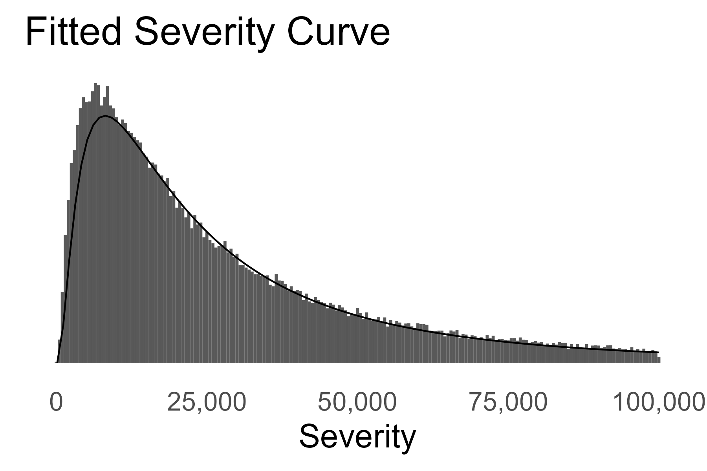
Text Size & Theme
We can increase text size and select a simpler theme.
p <- p +
theme_minimal(base_size = 20) +
theme(panel.grid.major = element_blank(),
panel.grid.minor = element_blank()) +
scale_x_continuous(labels = scales::comma) +
theme(axis.text.y = element_blank(),
axis.ticks.y = element_blank(),
axis.title.y = element_blank())

Slide 23
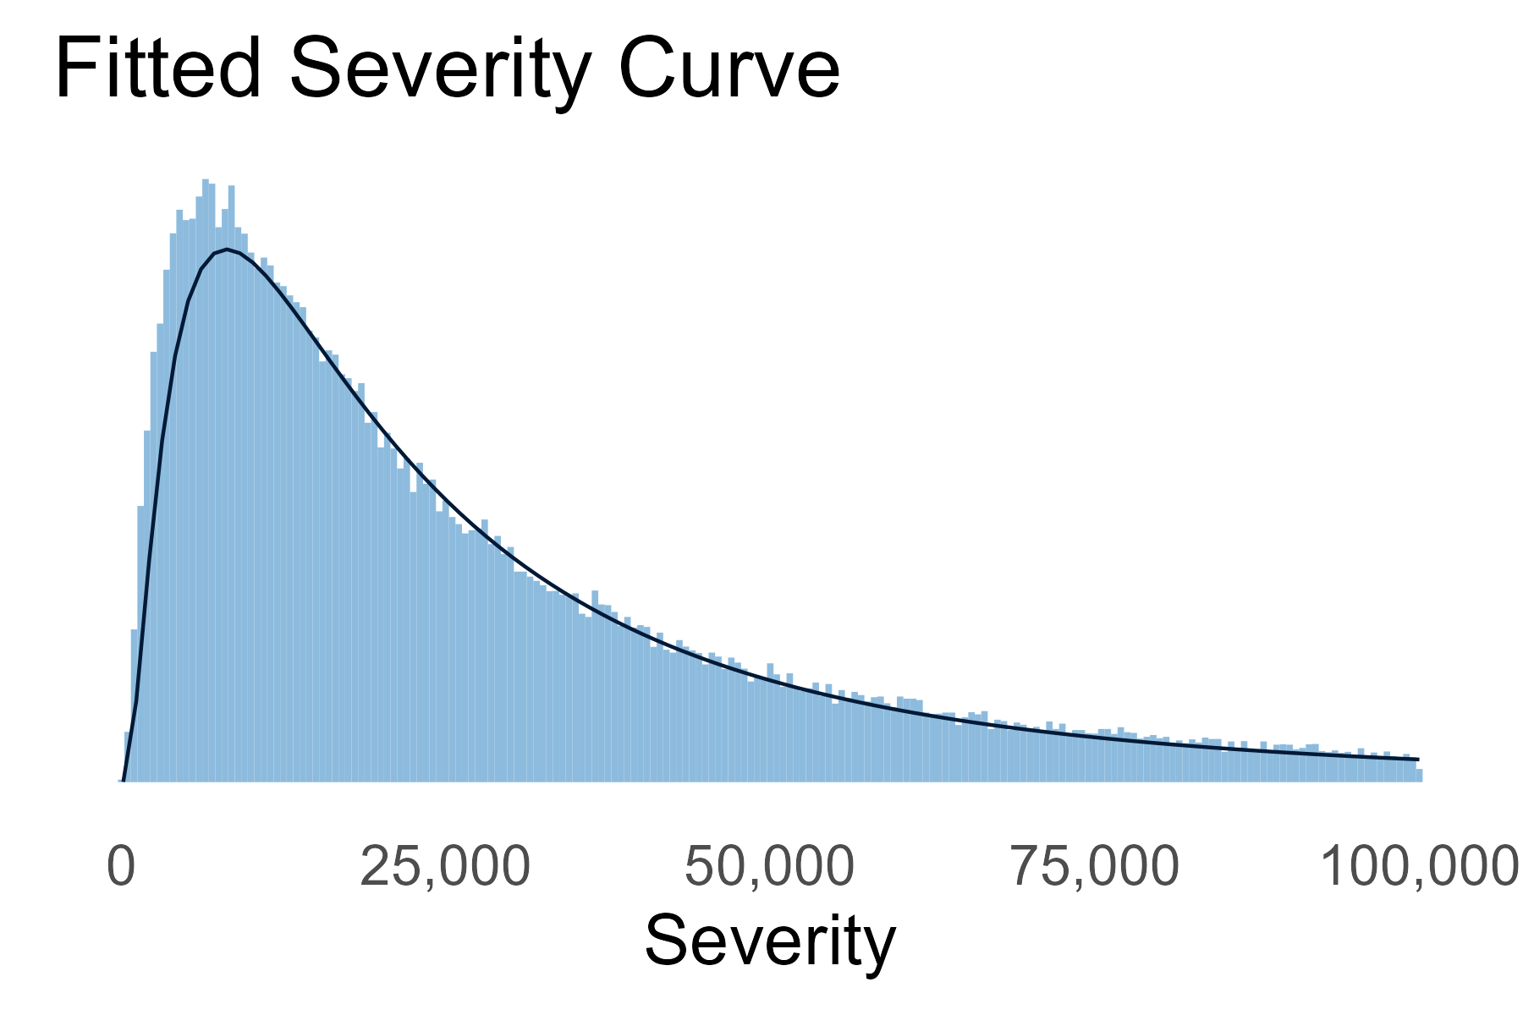
Color
We can also update the color, if desired.
...
geom_histogram(aes(x = loss, after_stat(density)),
fill = pal_CAS["light_blue"]) +
stat_function(fun = dlnorm,
args = list(meanlog = 10, sdlog = 1.0),
color = pal_CAS["dark_blue"]) +
...

Slide 24

Comparison

Slide 25
Appendix

Slide 26
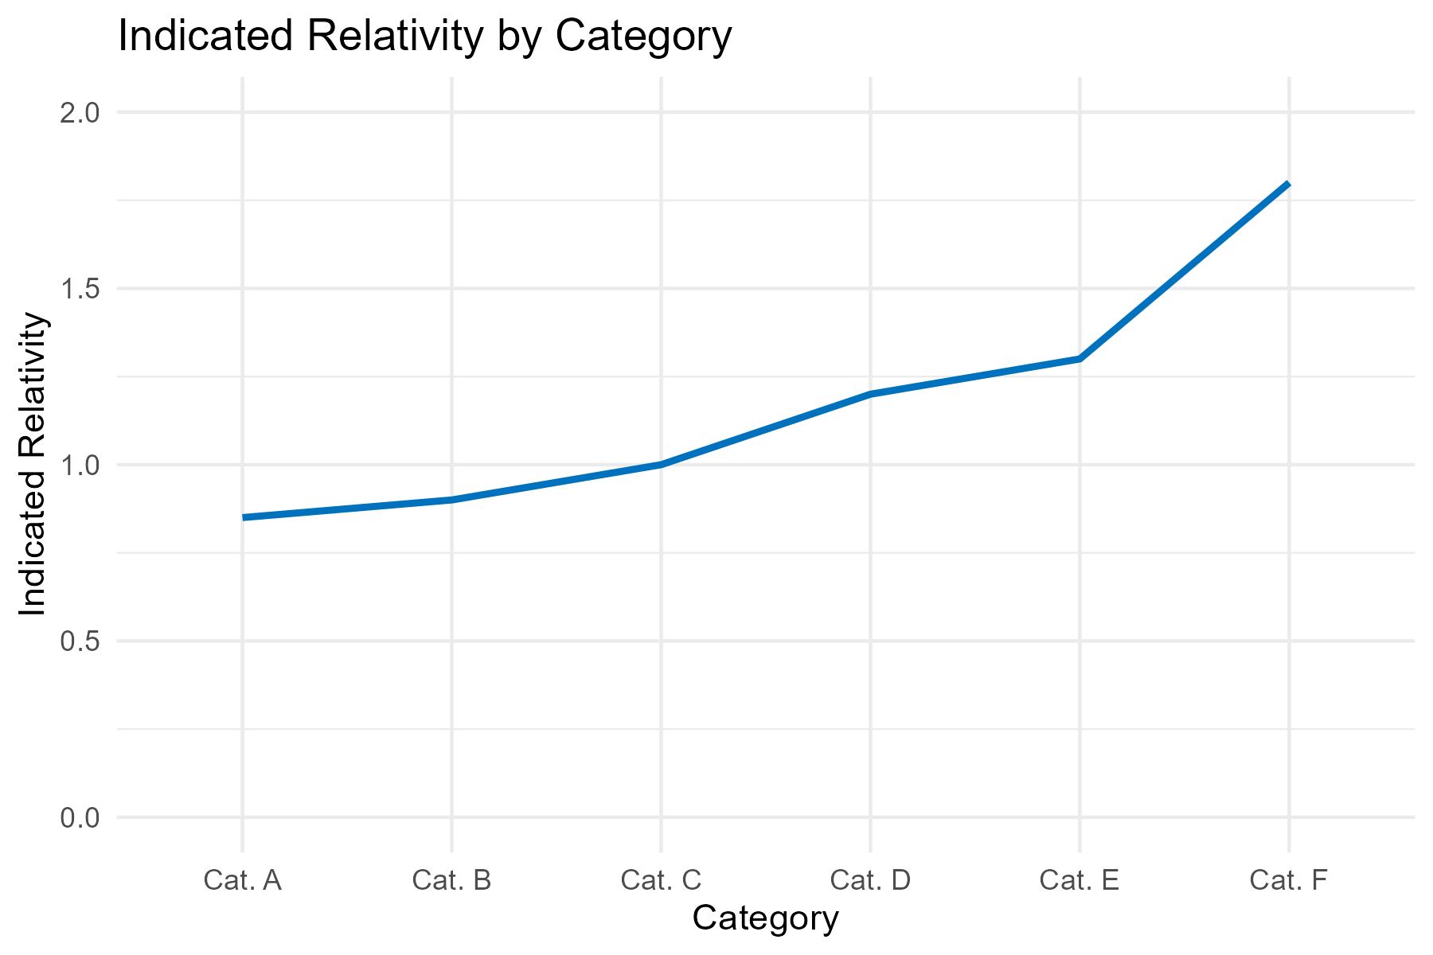
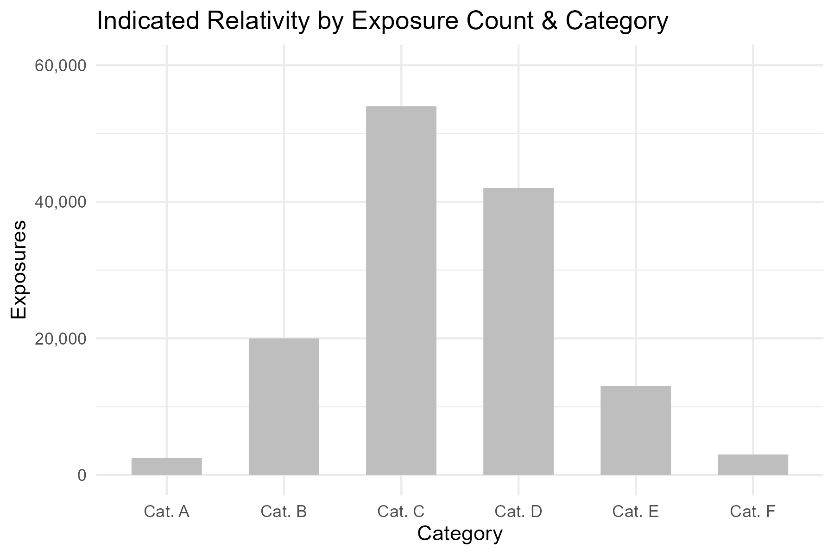
Two Axes vs Two Charts

Slide 27
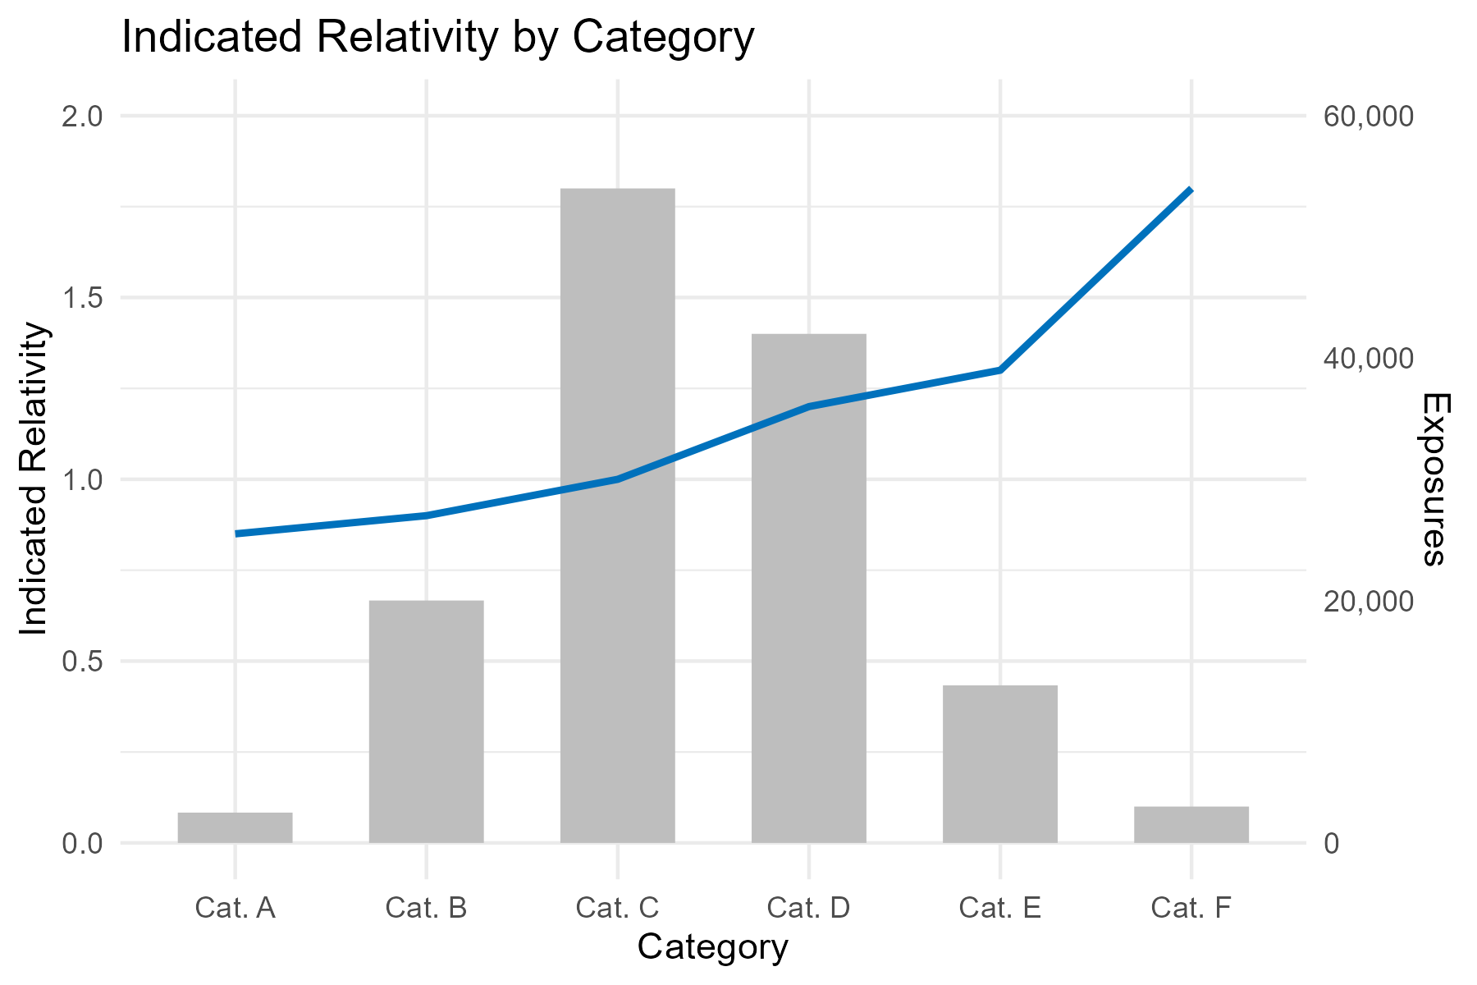
Two Axes vs Two Charts

Slide 28
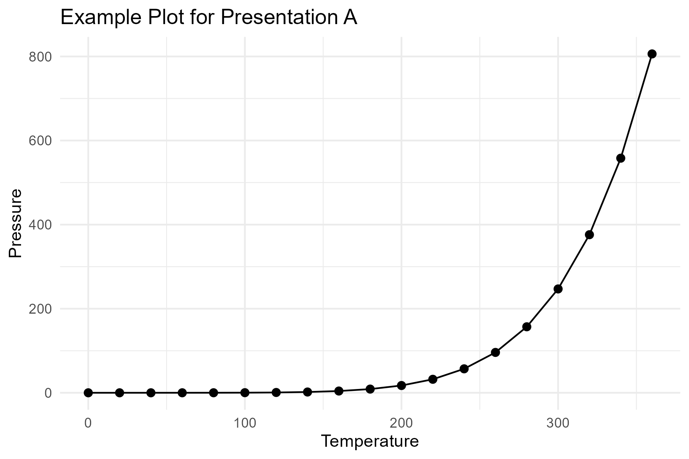
Example Plot A

Slide 29
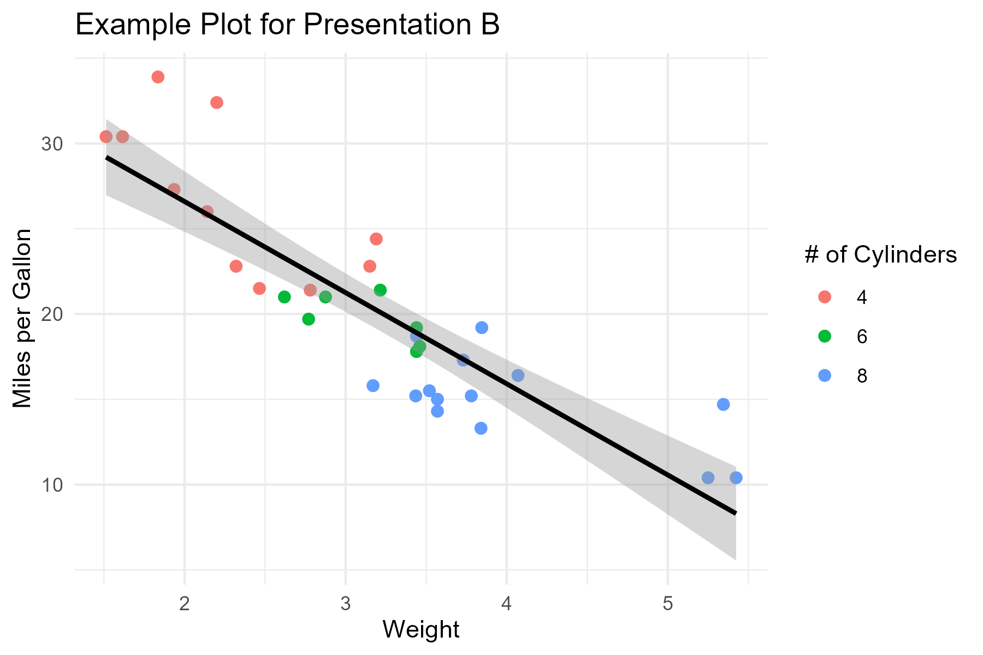
Example Plot B

Slide 30
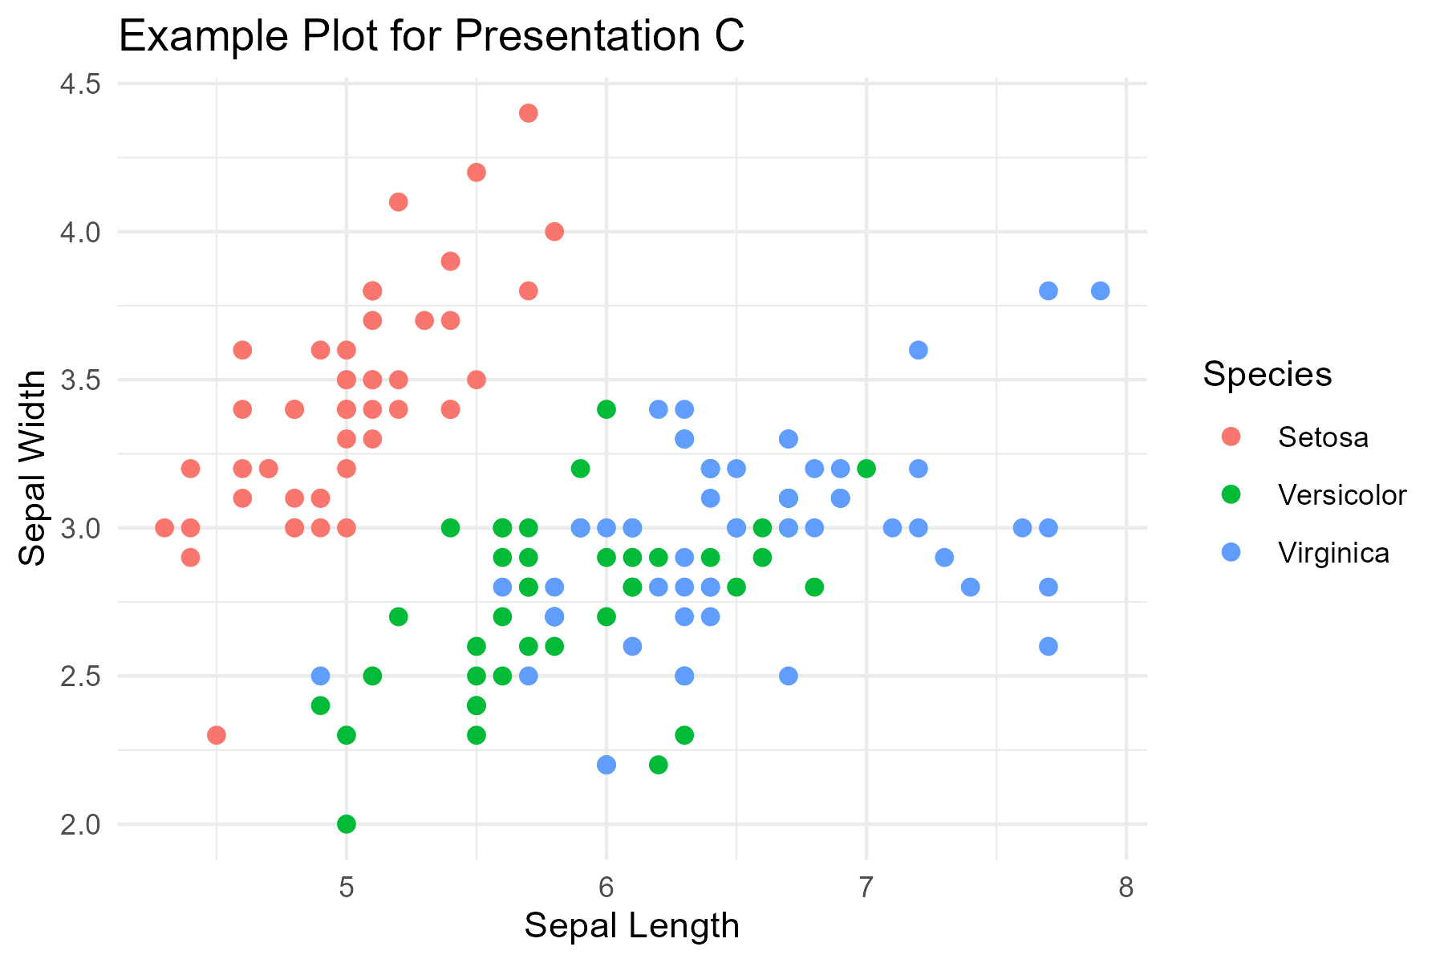
Example Plot C

